Slide 1



Correlation between media and its features
Ananya Subramaniam

Slide 2


Research Question
Is there is a correlation between the popularity of a show/movie and different factors (genres, runtime, seasons, release year)?
Hypothesis
NO CORRELATION

Slide 3

Data Structuring
id,title,type,description,release_year,age_certification,runtime,genres,production_countries,seasons,imdb_id,imdb_score,imdb_vote,
tmdb_popularity,tmdb_score
ts300399,Five Came Back: The Reference Films,SHOW,"This collection includes 12 World War II-era propaganda films — many of which are graphic and offensive — discussed in the docuseries ""Five Came Back.""",1945,TV-MA,48,['documentation'],['US'],1.0,,,,0.6,
tm84618,Taxi Driver,MOVIE,"A mentally unstable Vietnam War veteran works as a night-time taxi driver in New York City where the perceived decadence and sleaze feed his urge for violent action, attempting to save a preadolescent prostitute in the process.",1976,R,113,"['crime', 'drama']",['US'],,tt0075314,8.3,795222.0,27.612,8.2

Slide 4

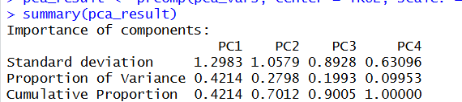
Data Cleanup
PCA
Found PCA for each row using the 4 variables
Added a new column (PC1) as a measurement for popularity
Some rows didn’t have all the values → had to exclude the rows with NA or null values
Divided the data based on low, med and high popularity
Lowest 33% = Low, Med 33% = Medium, Highest 33% = Highest

Slide 5
Data Cleanup
Split File into 2 subsets
One table for TV shows and another for movies
Cleaned up genre column
Genres were stored as a list
Mutated dataset
OG: Taxi Driver → [“crime”, “drama”]
New: 2 lines
Taxi Driver → “crime”
Taxi Driver → “drama”

Slide 6

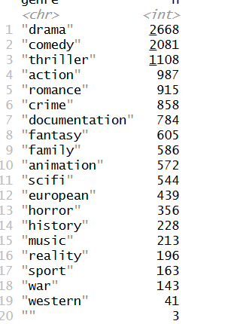
Descriptive Stats
19 Genres

Slide 7
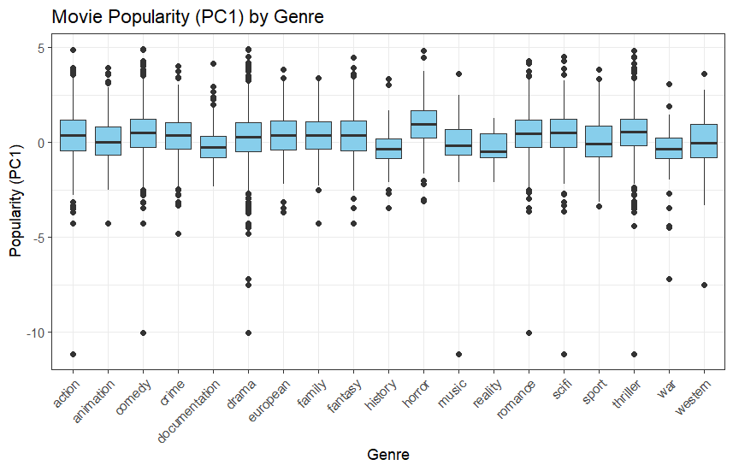
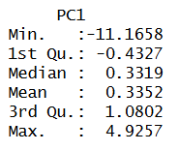
Descriptive Stats
Movies

Slide 8
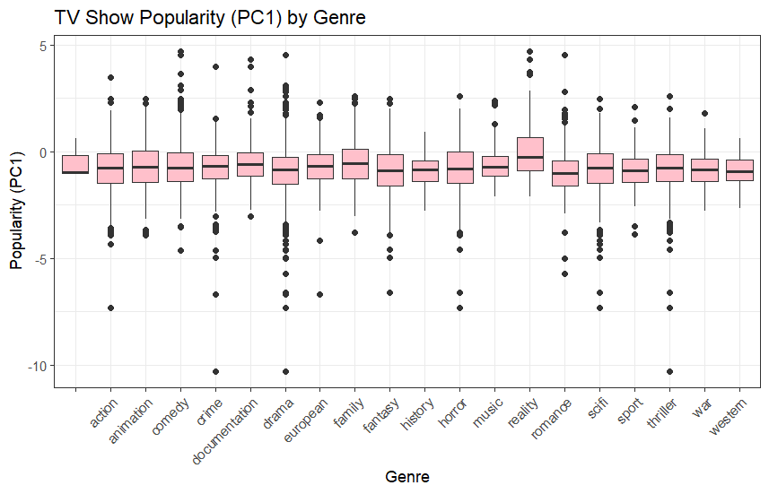
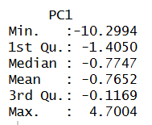
Descriptive Stats
TV Shows

Slide 9
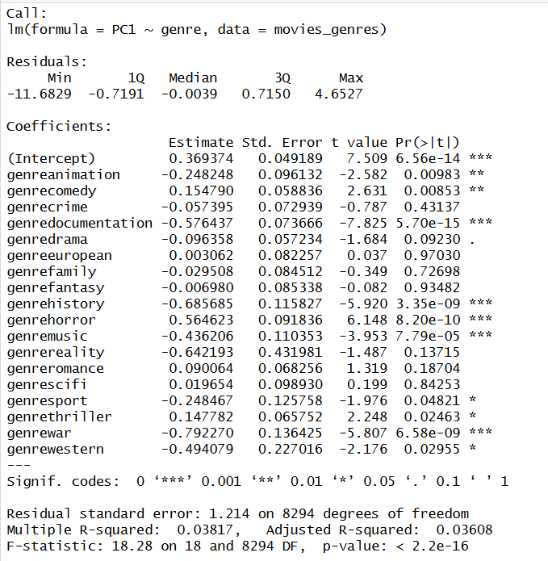
Linear Models
MOVIES
POPULATION ~ GENRE
Genre = categorical
Had to set a baseline (Action)
Coefficient of each genre tells us how much or less popular another genre is compared to Action
R^2 value → 3.6%
Does help in direct comparison between the genre popularities

Slide 10
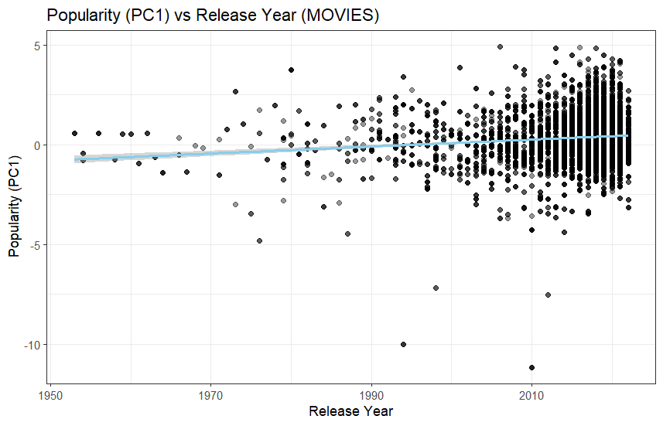
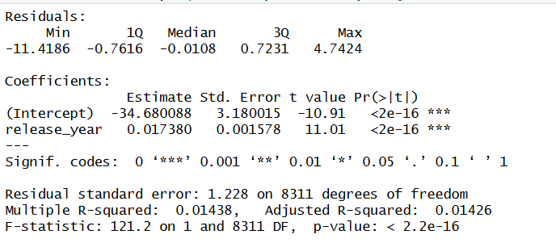
Linear Models
MOVIES
POPULATION ~ RELEASE YEAR
Upward slope → 0.017
2000-2020 → wider spread
R^2 → 1.4%

Slide 11
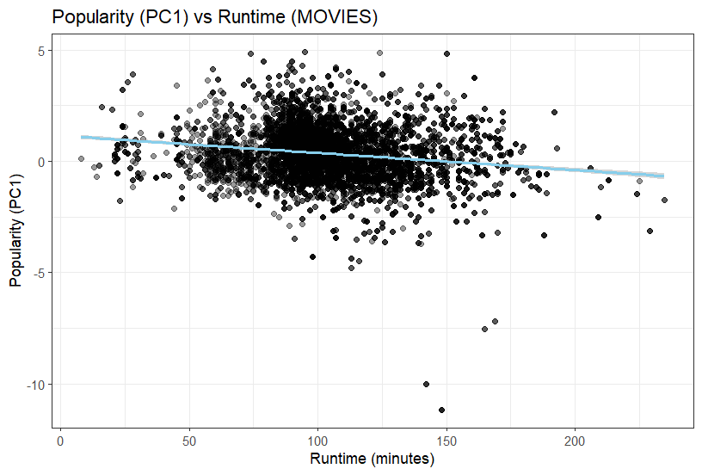
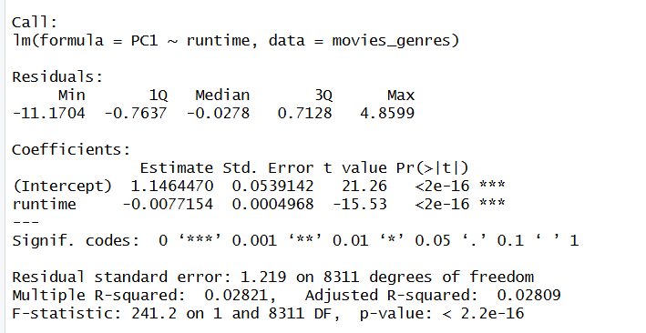
Linear Models
MOVIES
POPULATION ~ RUNTIME
Downward slope → -0.007
+90 mins → decrease by 0.69
Cluster around 80-120 mins
R^2 → 2.8%

Slide 12
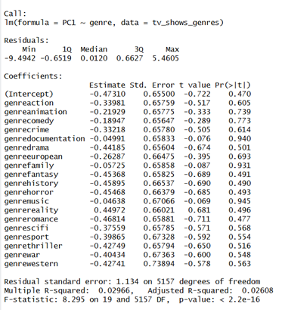
Linear Models
TV SHOWS
POPULATION ~ GENRE
R^2 value → 2.6%
Does help in direct comparison between the genre popularities

Slide 13
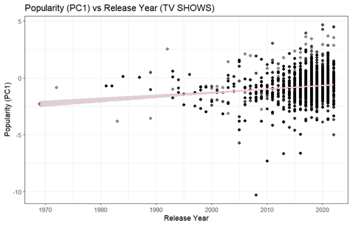
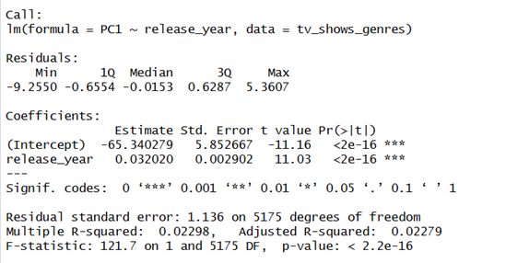
Linear Models
TV SHOWS
POPULATION ~ RELEASE YEAR
Upward slope → 0.03
2000-2020 → wider spread
R^2 → 2.2%

Slide 14
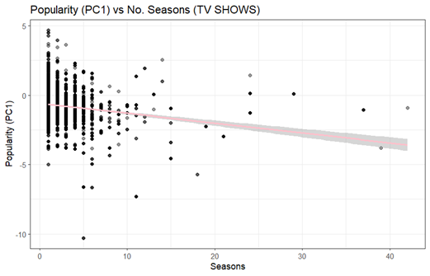
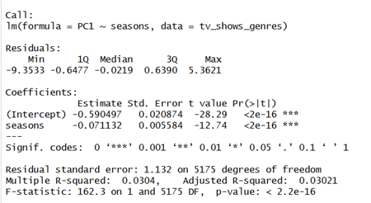
Linear Models
TV SHOWS
POPULATION ~ NO. SEASONS
Downward slope → -0.07
R^2 → 3%

Slide 15
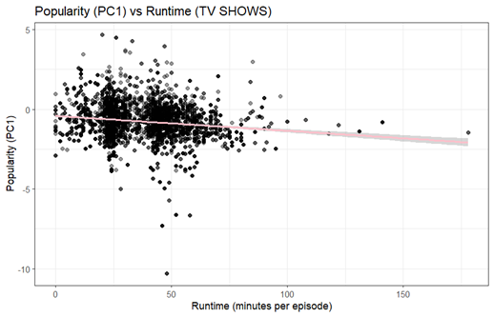
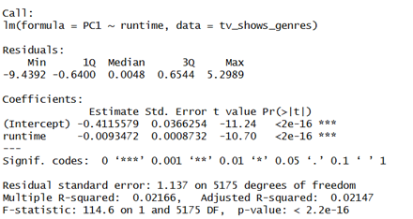
Linear Models
TV SHOWS
POPULATION ~ NO. SEASONS
Downward slope → -0.009
R^2 → 2%

Slide 16
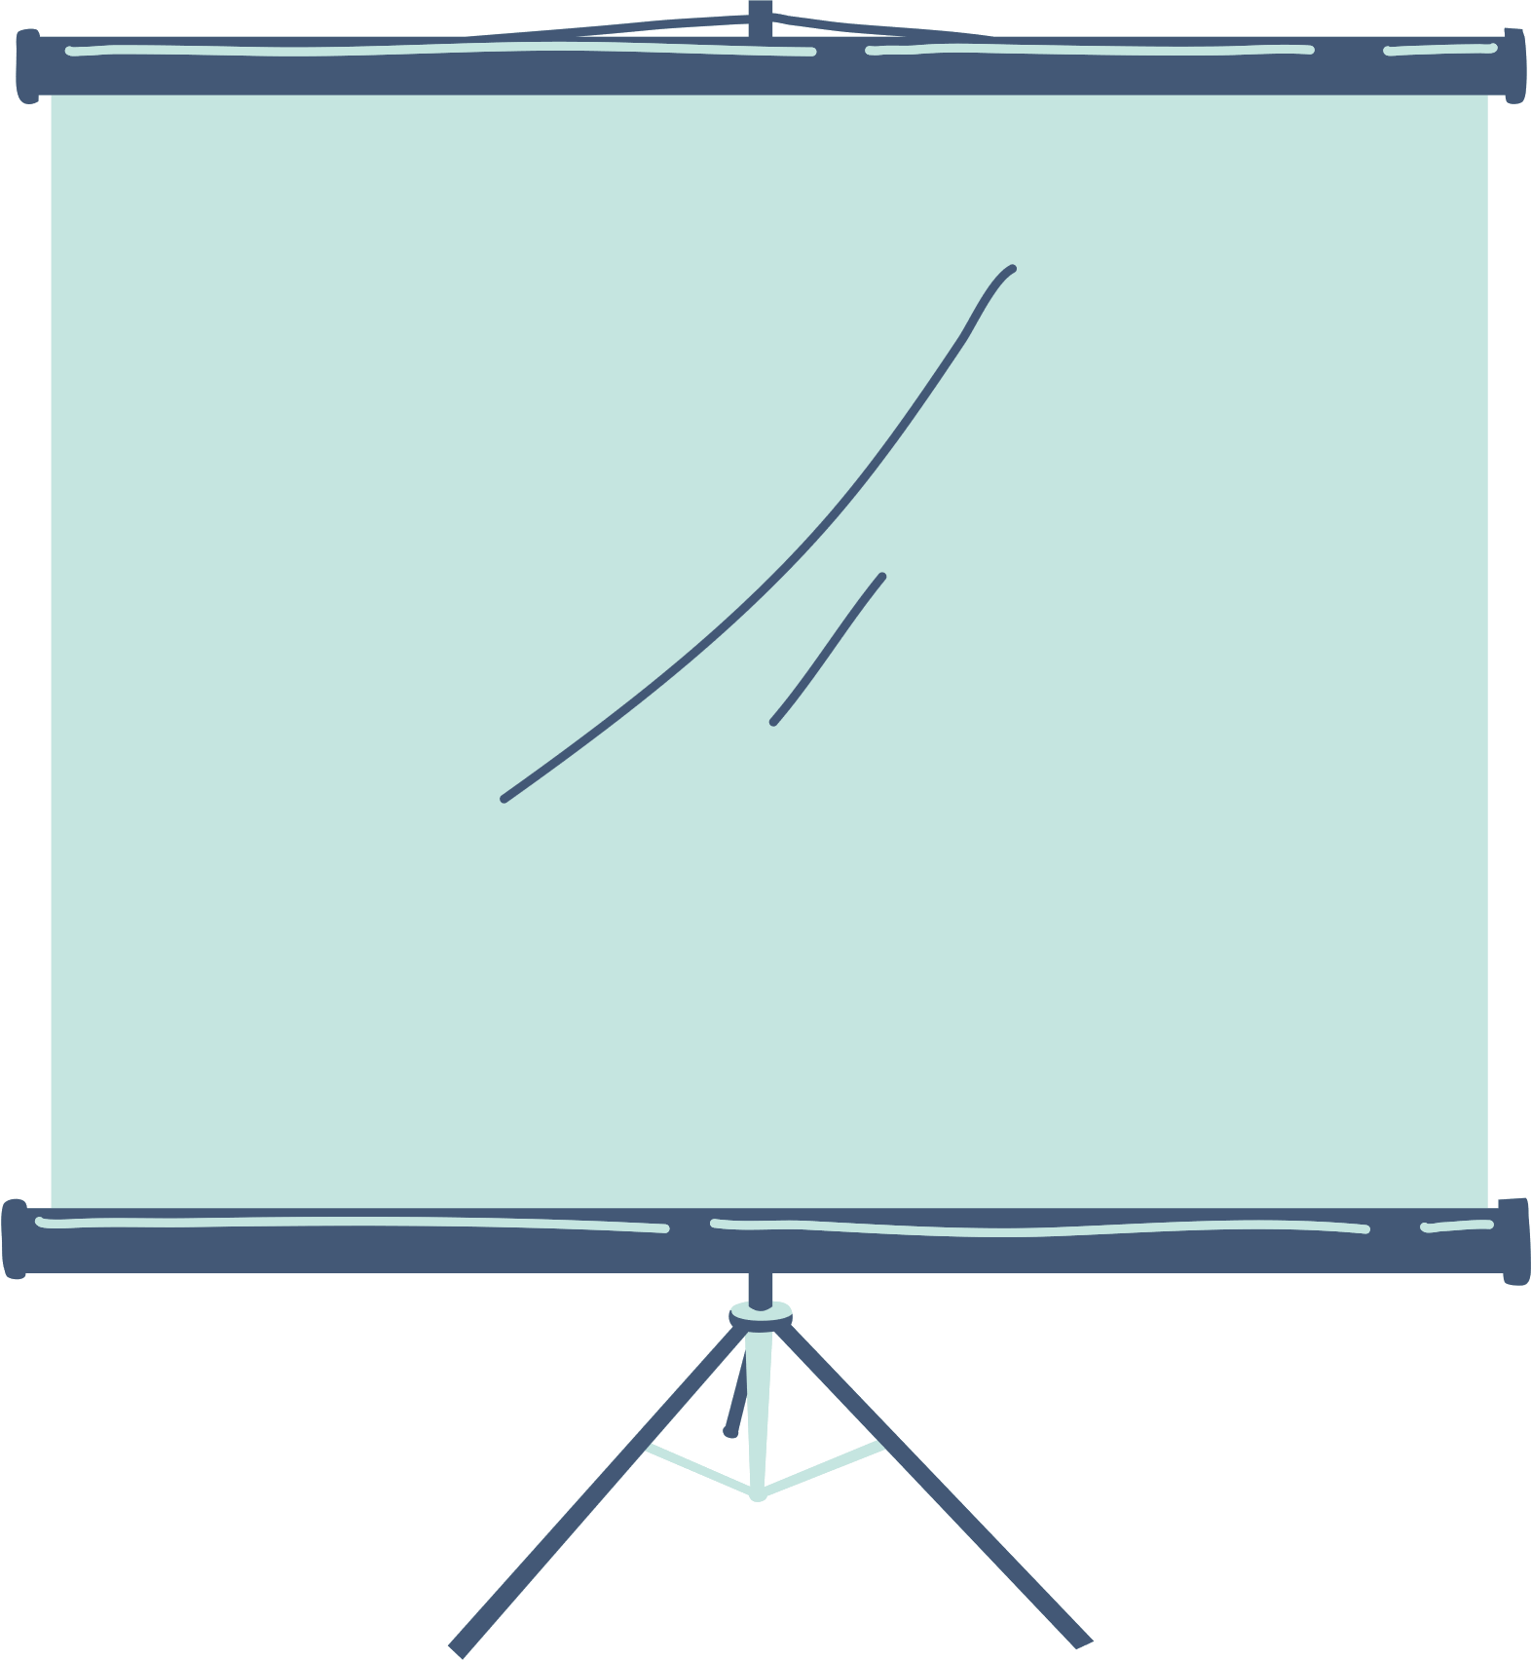
Linear Model Overview
TV Shows and Movies behave similar
Supports overall message of this analysis that there should not be a quantifiable way to determine popularity. Rather, it should be dependent on the work put in by creators and audiences alike.

Slide 17

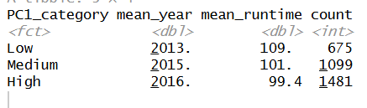
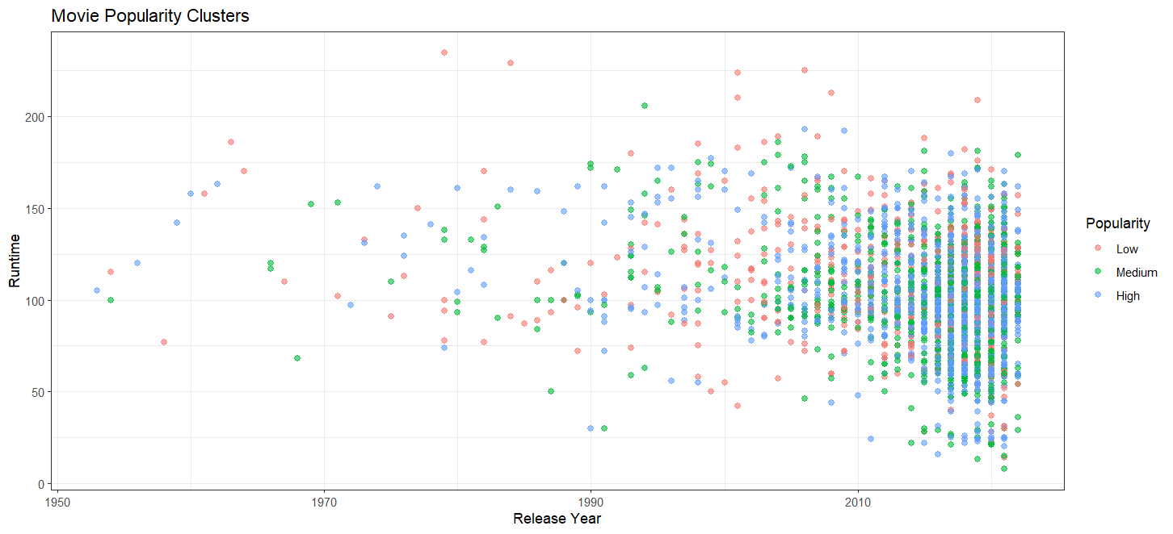
K MEANS CLUSTERING
Movies
High popularity Newer & shorter runtimes

Slide 18
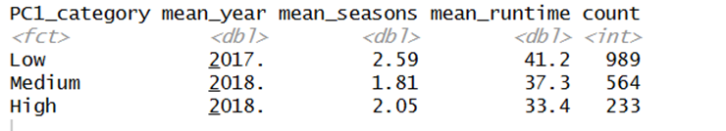
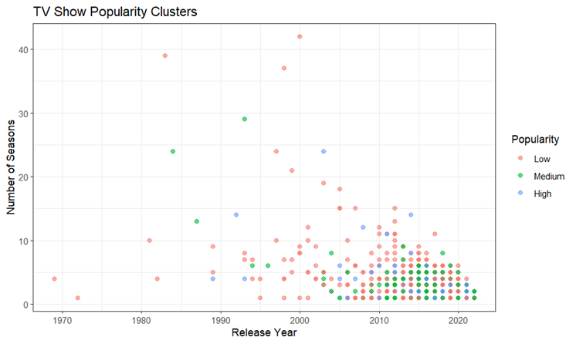
K MEANS CLUSTERING
TV
Shows
High popularity Newer & shorter runtimes
High & Low popularity
~2 seasons

Slide 19

Limitations
1.
3.
Omitted Rows because of PCA
Not all factors are taken into consideration
Delays → Covid-19, Writers strike
Affects release year or seasons of a show
Shows can be cancelled early based on network decisions even if it is popular
2.
4.
Comparing features against revenue would be better for a societal analysis
Could get a better picture about if people are influenced to create certain types of content because of statistics
Netflix Limited Data

Slide 20
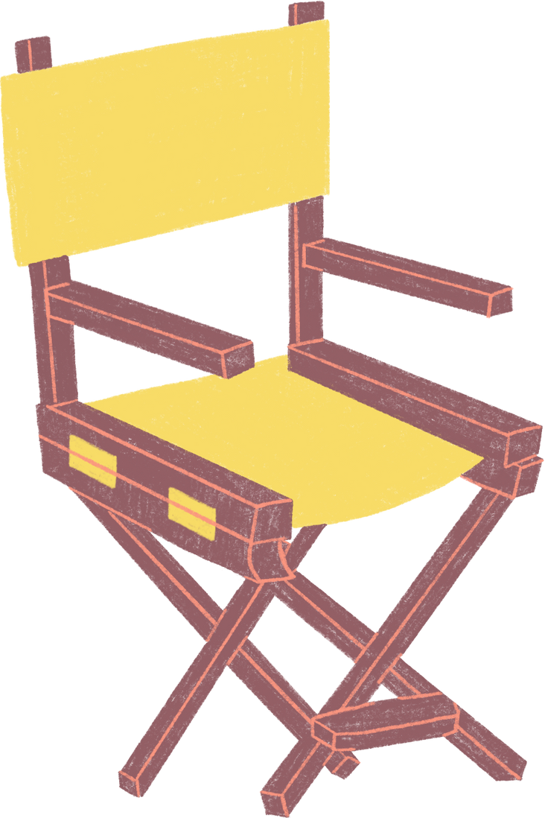
Takeaway
It is important to emphasize the importance of creating to say something rather than prove statistics. The no correlation output is significant because it means that people are spreading their voice without being constrained with the pressure of guaranteed successes.

Slide 21

Thank you!
Any questions?

Slide 22
Conclusion
Hypothesis was proven → There was no correlation

Slide 23

Use this presentation as a Google Slide template in 3 steps
1.
2.
3.
Click on the "Canva" button next to this presentation. Start editing your presentation. You may need to sign in to your Canva account.
Click on the "Share" button on the top right corner in Canva and click on "More" at the bottom of the menu.
Enter "Google Drive" in the search bar and click on the Google Drive icon to add this design as a Google slide in your G Drive. It will ask you to link your Google account to Canva the first time.

Slide 24

About us
Elaborate on what you want to discuss.

Slide 25

Welcome To Presentation
I'm Rain, and I'll be sharing with you my beautiful ideas.
Follow me at @reallygreatsite to learn more.

Slide 26


Write Your Idea
Briefly elaborate on what you want to discuss.
Briefly elaborate on what you want to discuss.
Briefly elaborate on what you want to discuss.
Briefly elaborate on what you want to discuss.

Slide 27


About Us
Who we are?
Briefly elaborate on what you want to discuss.
What we do?
Briefly elaborate on what you want to discuss.

Slide 28
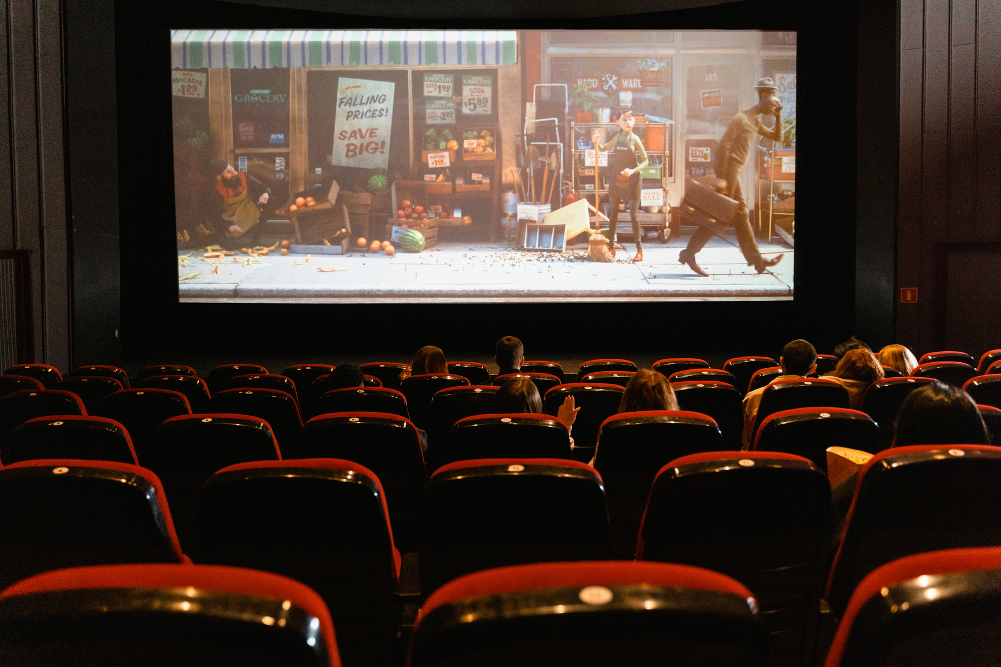


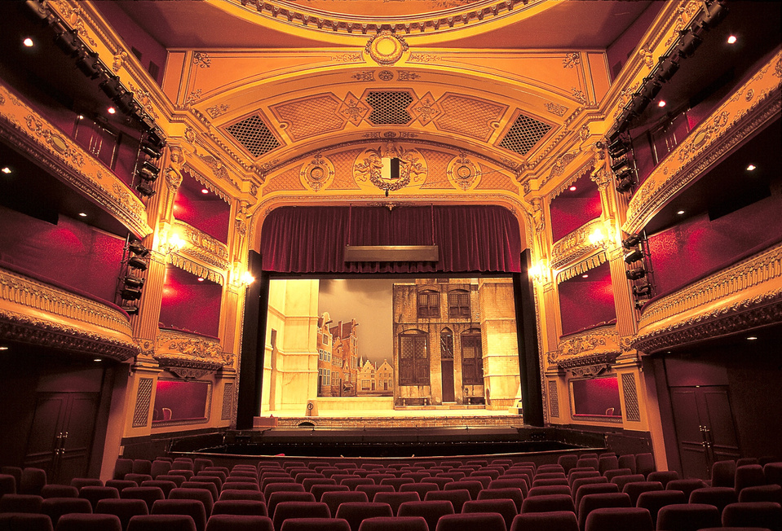


Gallery Image
What can you say about your projects?
Share it here!

Slide 29
Write an original statement or inspiring quote
— Include a credit, citation, or supporting message

Slide 30





Add a Team Members Page
Elaborate on what you want to discuss.
Name
Name
Name
Name
Title or Position
Title or Position
Title or Position
Title or Position

Slide 31


Our Projects
Elaborate on what you want to discuss.

Slide 32

Your Project
Presentations are communication tools that can be used as demonstrations, lectures, speeches, reports, and more. It is mostly presented before an audience. It serves a variety of purposes, making presentations powerful tools for convincing and teaching.
YEAR: 2022
ROLE: WRITE YOUR ROLE

Slide 33

A picture is worth a thousand words

Slide 34


Our Services
Service One
Service Two
Elaborate on what you want
to discuss.
Elaborate on what you want
to discuss.
Service Three
Service Four
Elaborate on what you want
to discuss.
Elaborate on what you want
to discuss.

Slide 35

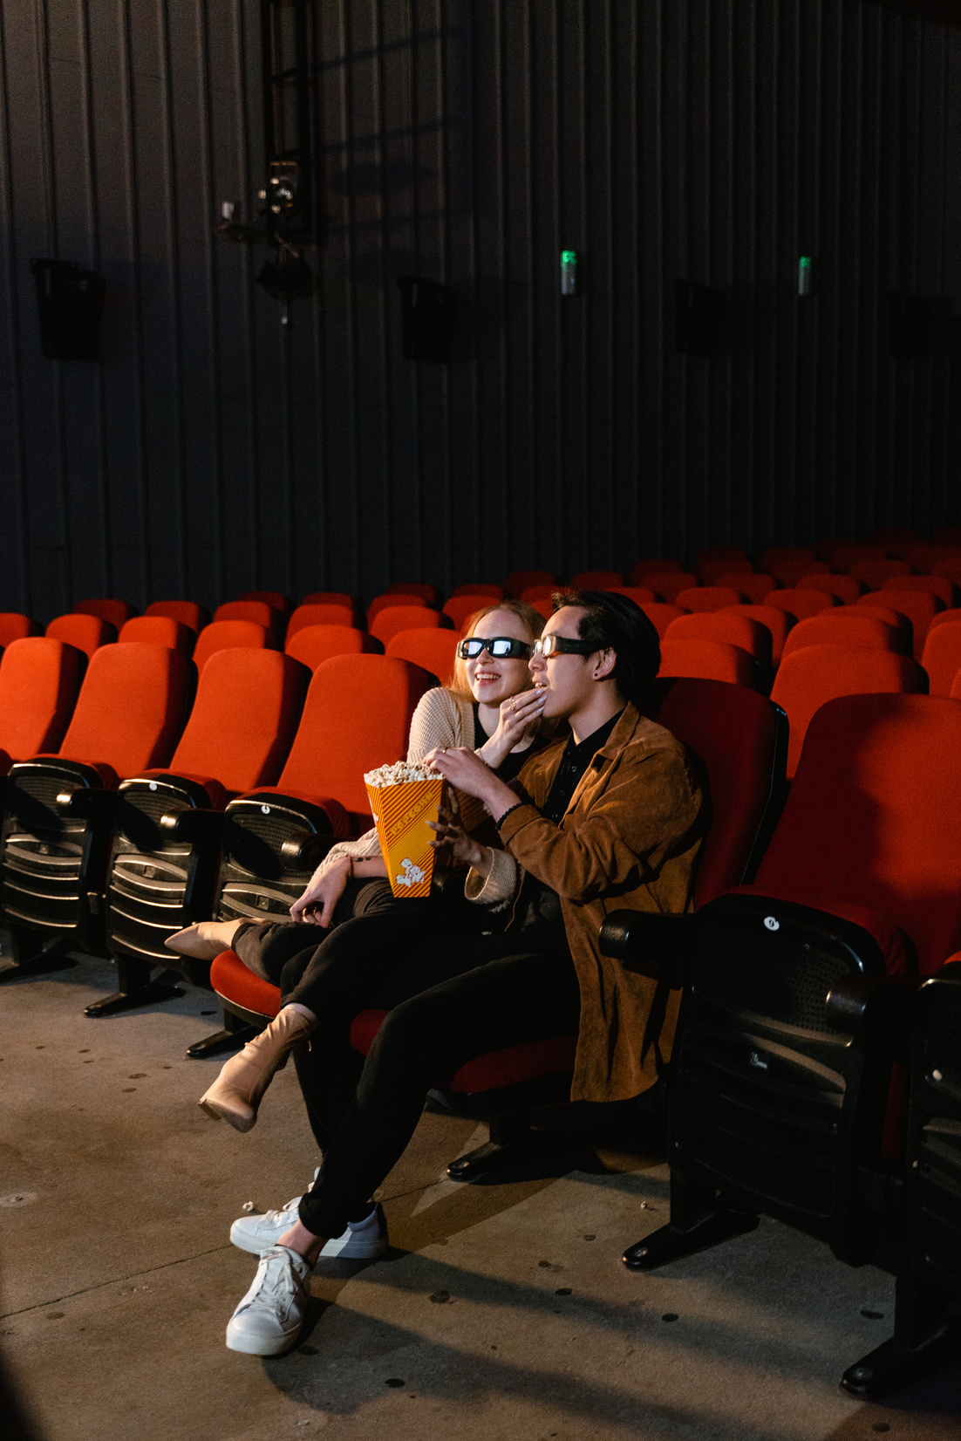
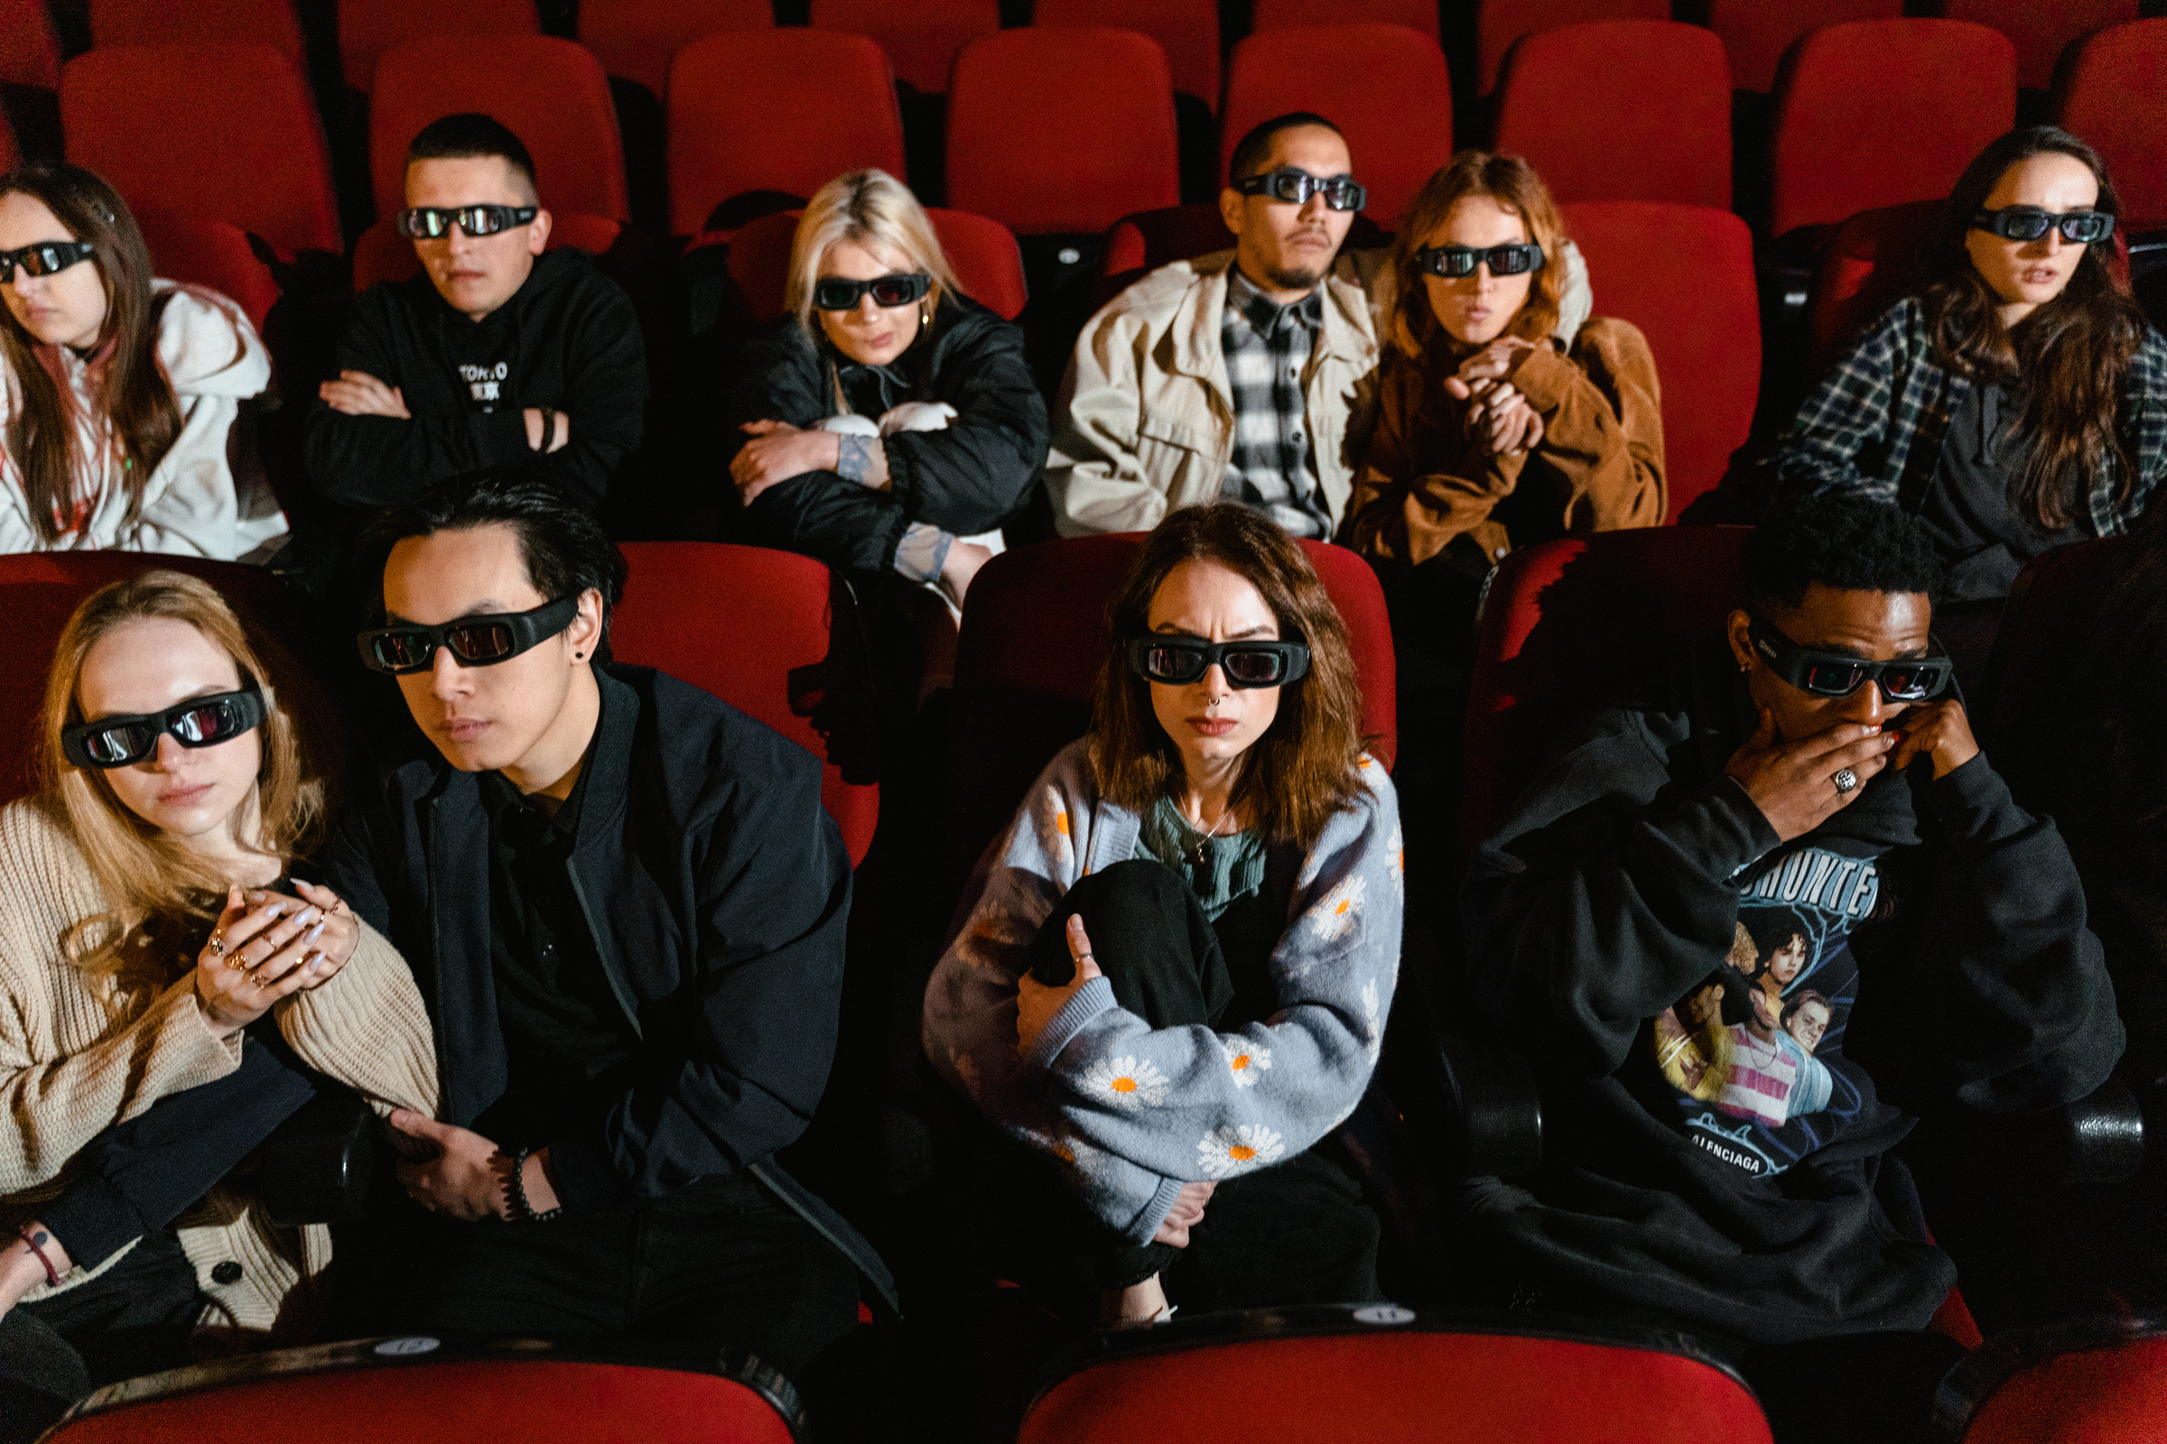
Phone
Mockup
What can you say about your projects? Share it here!

Slide 36
Write Your Big Topic or Idea
Presentations are communication tools that can be used as demonstrations, lectures, speeches, reports, and more.
It serves a variety of purposes, making presentations powerful tools for convincing
and teaching.

Slide 37

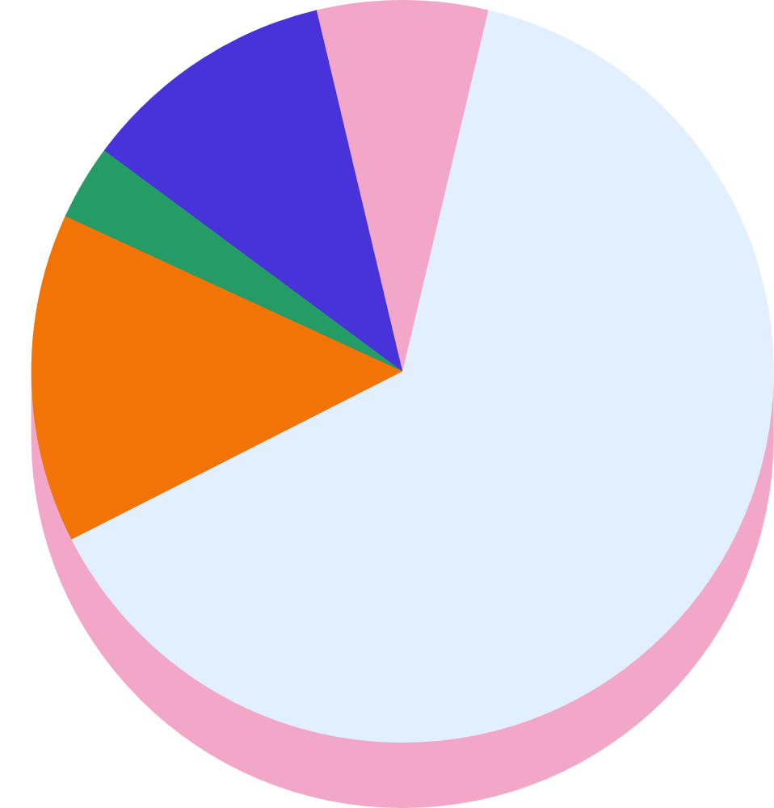

Stats & Numbers
Elaborate on what you want to discuss.

Slide 38

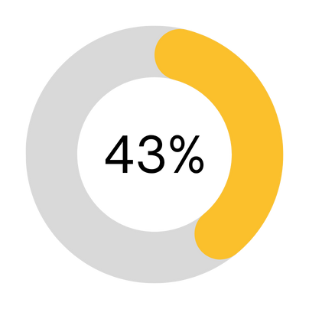
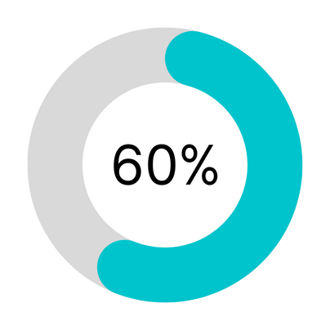
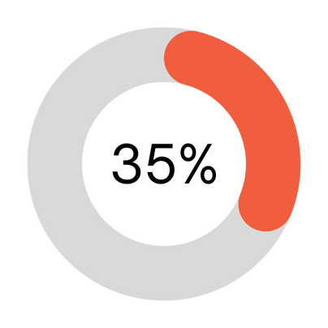

Infographic Slide Report
Elaborate on the featured statistic
Elaborate on the featured statistic.
Elaborate on the featured statistic.
Elaborate on the featured statistic.

Slide 39

2 out of 5
95%
Elaborate on the featured statistic.
12 million
Elaborate on the featured statistic.
Elaborate on the featured statistic.

Slide 40
S
W
STRENGTHS
WEAKNESSES
What are you doing well?
What sets you apart? What are your good qualities?
Where do you need to improve?
Are resources adequate? What do others do better than you?
O
T
OPPORTUNITIES
THREATS
What are your goals?
Are demands shifting?
How can it be improved?
What are the blockers you're facing?
What are factors outside of your control?

Slide 41






Contact Us
123 Anywhere St., Any City,ST 12345
123-456-7890
hello@reallygreatsite.com
@reallygreatsite
reallygreatsite.com

Slide 42

Credits
This presentation template is free for everyone to
use thanks to the following:
SlidesCarnival for the presentation template
Pexels for the photos
Happy designing!

Slide 43
Fonts In this Presentation
This presentation template uses the following free fonts:
Titles: Agrandir black
Headers: Kollektif bold
Body Copy: Kollektif
You can find these fonts online too. Happy designing!

Slide 44

Free templates for all your presentation needs
For PowerPoint, Google Slides, and Canva
100% free for personal or commercial use
Ready to use, professional,
and customizable
Blow your audience away with attractive visuals

Slide 45

Resource
Page
Use these design resources in your Canva Presentation.
Happy designing!
Don't forget to delete this page before presenting.

